Slide 1
Instrument and Tissue Handling Techniques

Slide 2
Surgical skills:
instrument handling,
tissue dissection and manipulation,
suturing,
knot tying,
hemostasis,
wound closure.
Surgical Principles Attributed to Halsted
• Handle tissue gently تعامل مع الانسجة برفق
• Control hemorrhage meticulously السيطرة على النزيف بدقة
• Observe strict aseptic technique التقيد بتقنية التعقيم الصارمة
• Preserve blood supply to tissues الحفاظ على تدفق الدم إلى الأنسجة
• Eliminate dead space القضاء على الفضاء الميت
• Appose tissues accurately with minimal tension تقابل الأنسجة بدقة وبأدنى حد من التوتر

Slide 3
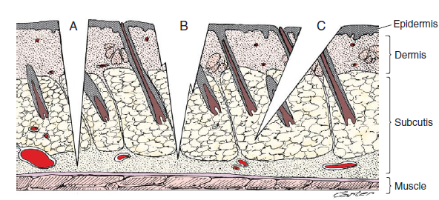
USE OF CUTTING INSTRUMENTS
Scalpel
Scalpels are used to make incisions in the skin and other tissues.
Scalpel incisions result in less crushing of tissue compared with scissor incisions.
Full-thickness skin incisions attained with a single sweep of the scalpel blade are the goal
الهدف هو إجراء شقوق جلدية بسمك كامل باستخدام مسحة واحدة لشفرة المشرط

Slide 4
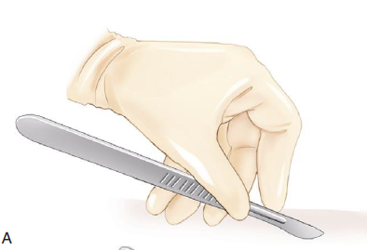
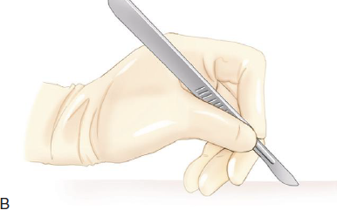
When tissues are incised, the scalpel handle is usually held in one of two ways:
fingertip grip or pencil grip .
The fingertip grip places the maximum length of the blade edge in contact with the tissue. It offers the greatest accuracy and stability in making long incisions, as movement is performed by the whole arm.
The pencil grip, which uses finger motion, is more accurate for short, delicate maneuvers.

Slide 5
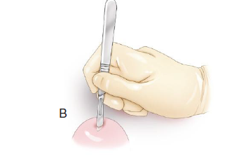
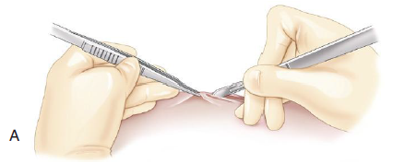

Four motions of the scalpel’s cutting edge may be used in surgery: sliding, pressing, sawing, and scraping.
Slide cuts yield precise depth, length, and control of direction and are used most commonly for making skin incisions.
Press cuts or stab incisions are useful for opening fluid-filled chambers or making initial entry into a body cavity.
Pressure and motion occur in the same direction with a press cut, but depth is poorly controlled.

Slide 6
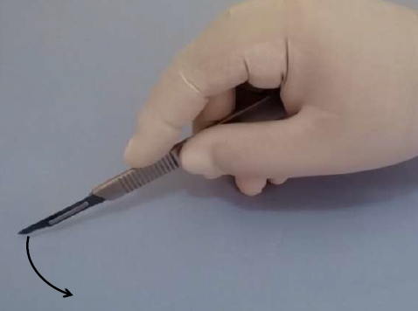
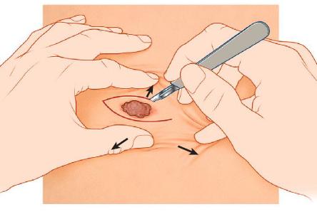
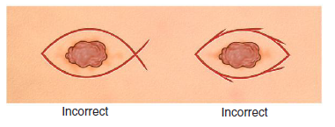
Sawing (e.g., transecting a ligated pedicle) allows continuation of a cut without removal and reinsertion of the blade. The novice surgeon may use a sawing motion when incising the skin. Such poor technique leads to unnecessary tissue trauma and, frequently, to delayed wound healing.
تسمح حركة المنشار (على سبيل المثال ، قطع السيقان المربوطة) باستمرار القطع دون إزالة النصل وإعادة إدخاله. قد يستخدم الجراح المبتدئ حركة المنشار عند شق الجلد. يؤدي هذا الأسلوب الرديء إلى إصابة الأنسجة غير الضرورية ، وفي كثير من الأحيان إلى تأخير التئام الجروح.
Scraping is a method of separating tissue layers.
القشط هو طريقة لفصل طبقات الأنسجة.
The latter two motions are used selectively by experienced veterinary surgeons
Stabilize tissues when incising with a scalpel by using the tips of the thumb and forefinger of the nondominant hand to tense adjacent tissue

Slide 7
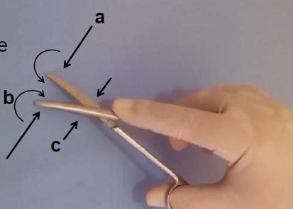
Scissors
Scissors are used to cut or dissect tissue and to cut inanimate objects, including paper drapes and suture material. Cutting of inanimate objects should be limited to specific instruments.
Three forces are used when cutting with scissors: closing, shearing, and torque.
تستخدم ثلاث قوى عند القطع بالمقص: الإغلاق والقص وعزم الدوران.
a. Closing force causes the blades to come together;
تؤدي قوة الإغلاق إلى تجمع الشفرات معًا
b. torque rolls the leading edges of each blade inward to touch the other
يقوم عزم الدوران بتدوير الحواف الأمامية لكل شفرة إلى الداخل للمس الأخرى
c. shearing force pushes one blade flat against the other during closing
تدفع قوة القص إحدى الشفرات نحو الأخرى أثناء الإغلاق

Slide 8
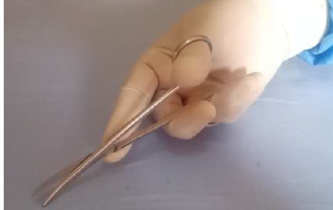
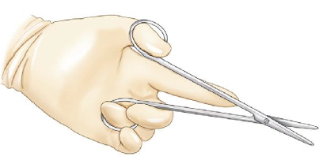

The gripping motion of scissors
A tripod grip is recommended when using scissors, because it provides maximal control.
A tripod grip is achieved by inserting the tips of the thumb and ring finger through the rings and placing the index fingertip near the fulcrum
يتم تحقيق قبضة حامل ثلاثي القوائم عن طريق إدخال أطراف الإبهام والبنصر من خلال الحلقات ووضع طرف الإصبع بالقرب من نقطة الارتكاز

Slide 9
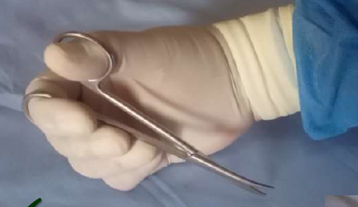


Slide 10
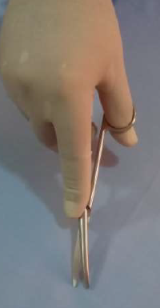
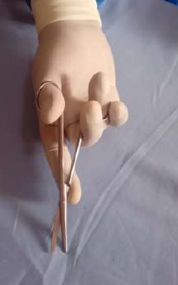
Curved scissors offer greater maneuverability and visibility, whereas straight scissors provide greater mechanical advantage for cutting dense tissue.
يوفر المقص المنحني قدرة أكبر على المناورة والرؤية ، بينما يوفر المقص المستقيم ميزة ميكانيكية أكبر لقطع الأنسجة الكثيفة.

Slide 11
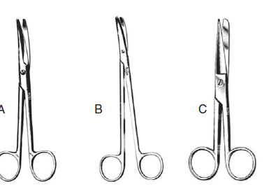
Scissors are used for dissection of two types: sharp or blunt
يمكن إجراء تشريح حاد عن طريق إجراء قطع تقليدي
Blunt dissection is accomplished by inserting the closed tips of scissors into lax tissues and then opening and withdrawing the points to break down connections and define important structures.
Blunt dissection, in general, should be minimized, as excessive dead space and tissue trauma may result.
Metzenbaum and Mayo scissors are used to cut and dissect tissues; utility or operating scissors are usually used to cut inanimate objects. Metzenbaum scissors are reserved for more delicate tissues.
مقصات Mayo أكثر ثباتًا وتستخدم على الأنسجة الضامة الثخينة.

Slide 12
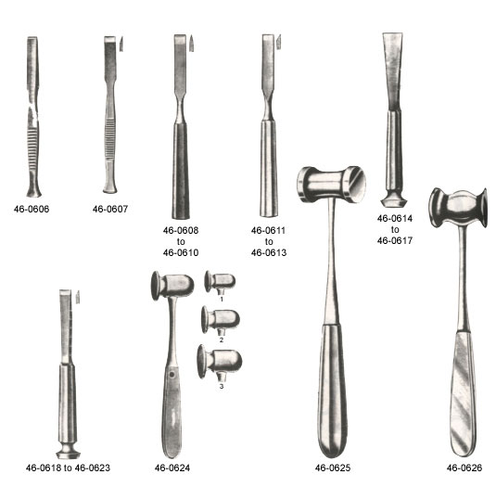
Other Cutting Instruments
The most controlled cut with bone-cutting chisels and osteotomes is induced by a mallet.
Holding the cutting instrument by using a palmed grip in the nondominant hand helps guide the direction of the cut.
يساعد إمساك أداة القطع باستخدام قبضة اليد في اليد غير المهيمنة في توجيه اتجاه القطع.

Slide 13
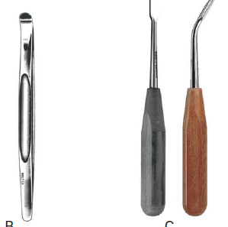

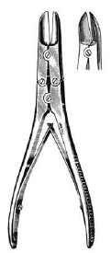
Curettes are held in a pencil grip and are manipulated by using back-and-forth rotating motions or pulling strokes.
Periosteal elevators are usually manipulated by using a controlled pushing stroke.
عادة ما يتم التلاعب برافع السمحاق باستخدام ضربة دفع مسيطر عليها.
Bone-cutting forceps are manipulated by using a palmed grip with the dominant hand.
يتم التعامل مع ملقط قطع العظام باستخدام مسكة قبضة اليد باليد المهيمنة.
Bone-cutting forceps

Slide 14
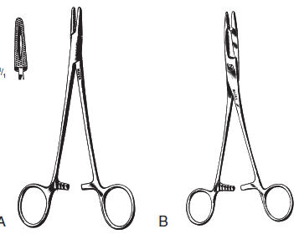
USE OF GRASPING INSTRUMENTS
Needle Holders
used only on inanimate objects. Combination needle holder and scissors (e.g., Olsen-Hegar) may be preferred by solo surgeons because of the potential for enhanced efficiency
تستخدم فقط على الأشياء غير الحية ،قد يفضل الجراحون المنفردون ماسك الإبرة والمقصOlsen-Hegar

Slide 15
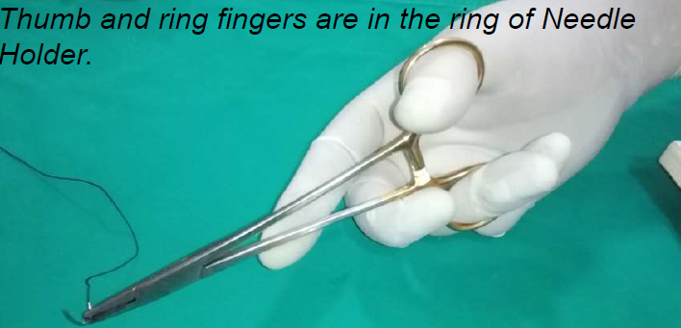
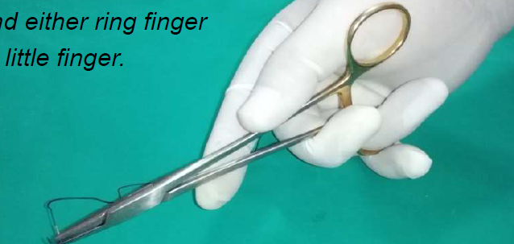
Four grips may be used in manipulating the needle holder: thumb–ring finger (tripod), thenar, palmed, and pencil grip.
The thumb–ring finger (tripod) grip provides for precise needle grasping and release and is well suited for delicate work.
توفر قبضة الإبهام والبنصر (الحامل ثلاثي القوائم) إمساكًا دقيقًا للإبرة وتحريرها وهي مناسبة تمامًا للعمل الدقيق.
When the thenar grip is used, the needle holder is grasped between the ball of the thumb (thenar eminence) and the ring finger
thumb–ring finger (tripod),
thenar grip

Slide 16
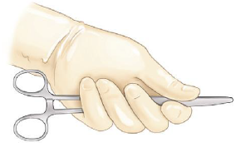
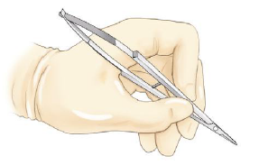
The palmed grip is the strongest grip, provides the greatest needle pressure and control in dense tissue, and provides for maximal wrist rotation; however, needle release and grasping often require adjusting to another grip, as neither ring is immediately accessible to fingertips.
The pencil grip is best suited for needle holders with spring handles (e.g., ophthalmic needle holders). It allows needle control with fine digital movement.
The palmed grip
The pencil grip

Slide 17

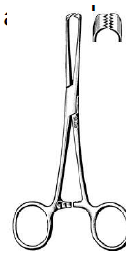
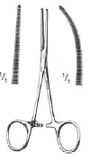
Forceps
بشكل عام ، يتم استخدام الملقط بطريقتين مختلفتين: للإمساك بالأنسجة أو الفصل الاعمى.
يتم استخدام معظم الملقط إما لإمساك الأنسجة (على سبيل المثال ، ملقط نسيج Allis أو Babcock ، ملقط Kocher ، ملقط Doyen المعوي) أو للفصل الاعمى (على سبيل المثال ، ملقط الزاوية اليمنى).
Three types of forceps are described: crushing, noncrushing, and hemostatic.
Crushing-Type Tissue Forceps
كل من ملاقط نسيج Allis و Babcock لهما مستوى قبضة عمودي على اتجاه السحب. كل منها له تأثير سحق على الأنسجة ويجب عدم استخدامها على الأنسجة المقرر أن تبقى مع المريض.
Kocher forceps يمكن استخدامه على الأنسجة الأكثر كثافة التي سيتم استئصالها.
Crushing-type tissue forceps are most suitable for static tissue holding during dissection around the secured tissue.
Babcock
Allis

Slide 18
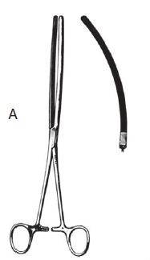
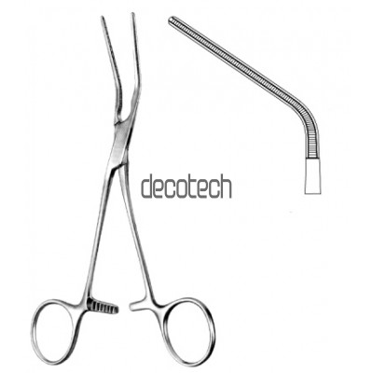
Doyen intestinal forceps, as duration of application increases, induce tissue trauma. Digital intestinal occlusion by an assistant provides an alternative, seemingly less traumatic, method.
Small size and atraumatic nature, various peripheral vascular forceps (e.g., patent ductus arteriosus clamp) may be used to achieve temporary intestinal occlusion in selected instances (e.g., feline subtotal colectomy).
Cardiovascular forceps provide tissue occlusion without cutting or crushing the blood vessel wall.
Doyen intestinal forceps
eBakey Atraumatic Blood Vessel Forceps‏D

Slide 19
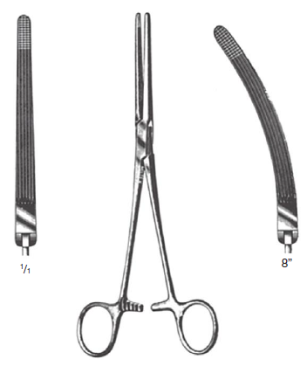
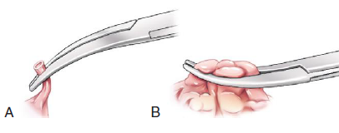
Hemostatic forceps are used during surgical procedures, either to isolate bleeding points or to bluntly dissect tissue.
Hemostats may be used in of two clamping techniques: either tip clamping or jaw clamping.
In general, hemostats with transversely oriented serrations (e.g., Halsted mosquito, Crile, Kelly forceps) are designed to grasp small amounts of tissue with the tip of the forceps directed toward the open vessel.
Forceps with longitudinally oriented serrations (e.g., Rochester-Carmalt forceps) are designed to grasp larger amounts of tissue (e.g., ovarian pedicle) with the jaw, such that the tip of the forceps is pointing away from the vessel.
tip clamping jaw clamping.
Rochester-Carmalt forceps

Slide 20
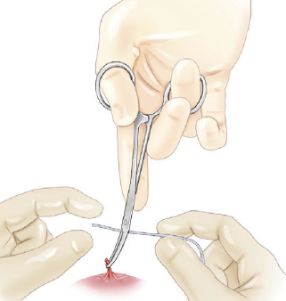
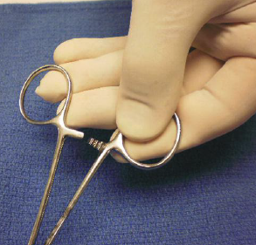
jaw clamping facilitates placement of ligatures during tying, but it also results in increased tissue trauma.
Use the dominant hand and a tripod grip to place the forceps most accurately and securely.
Forceps with curved tips should be placed with their tips directed upward to facilitate ligation of bleeding points
The tripod grip using the dominant hand is one option, a palmed grip using the nondominant hand may also be used
palmed grip
tripod grip

Slide 21
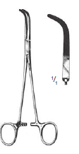
يتم إجراء Blunt dissection خاصة حول الاوعية الدموية والتراكيب الاخرى بسهولة باستخدام ملقط قاطع النزف. غالبًا ما تساعد هذه الملاقط ذات الأطراف المنحنية المدببة في تحقيق هدف العزل التام للتراكيب التشريحية. الملقط ذو الزاوية اليمنى مناسب تمامًا للعزل الاعمى حول الأوعية. عادة ما يتم توجيه Blunt dissection بالتوازي مع الوعاء

Slide 22
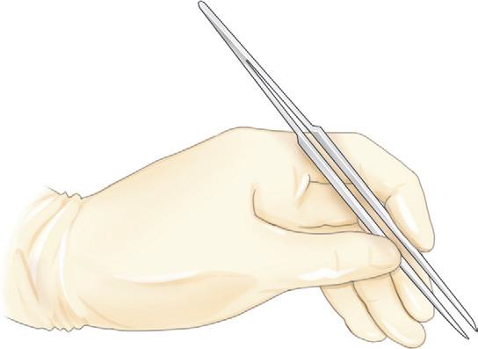
Thumb Forceps
They usually are used in concert with needle holders, scissors, or other forceps and are held in the nondominant hand
enabling the operator to grasp tissue during dissection or suture placement
the proper way to hold a thumb forceps using the thumb and forefinger of the nondominant hand

Slide 23
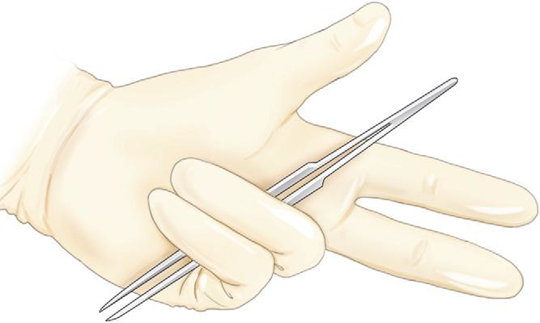
Method of holding thumb forceps in the palm of the nondominant hand when they are temporarily not in use

Slide 24
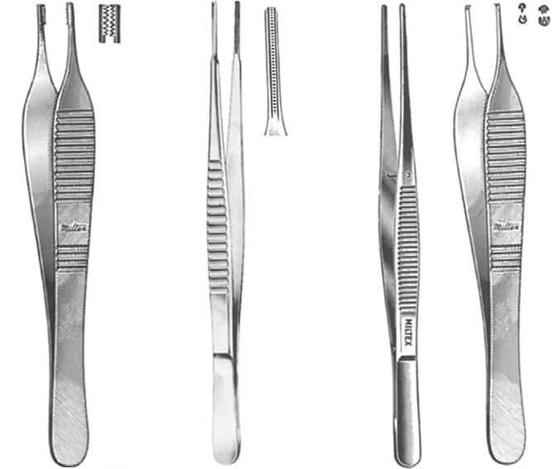
A B C D
A, Brown-Adson; B, DeBakey, C, dressing; and D, Adson forceps.
Brown-Adson thumb forceps stabilize tissue with minimal pressure.
DeBakey forceps are preferred for handling most tissues in body cavities because of their ribbed configuration
Nontoothed thumb forceps (e.g., dressing forceps) are designed to grasp inanimate objects, such as gauze sponges.

Slide 25
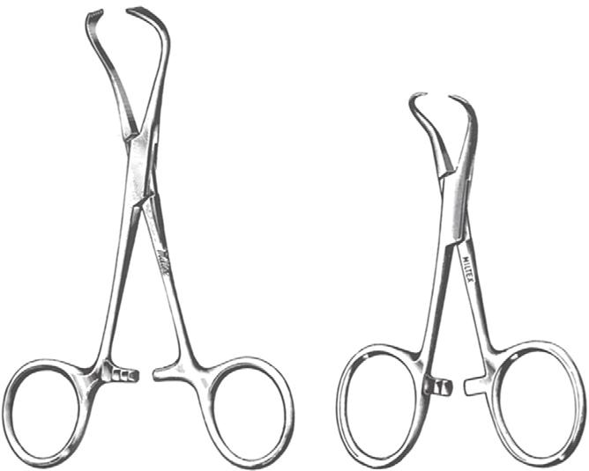
Clamps
To avoid a potential source of contamination, penetrating-type towel clamps should not be used to penetrate the overdrape.
Nonpenetrating instruments (e.g., Allis tissue forceps, Lorna- Edna towel clamps) are used instead.
Penetrating towel clamps may be utilized to provide traction to tissues during excision. They also may be used to temporarily counteract tension across an incision during closure.
Backhaus (penetrating) clamp
Lorna - Edna (nonpenetrating) clamp.

Slide 26
RETRACTORS
Retractors help improve exposure by deflecting tissue away from the area of interest in the surgical field.
تساعد المُبعِدات في تحسين الوصول عن طريق إبعاد الأنسجة عن المنطقة المهمة في العملية الجراحية.
Retractors are of two types: basic exposure and minor variation.
Basic exposure retractors provide static, long-term retraction of the wound and are usually self-retaining varieties.
Minor variation retractors provide short-term retraction and are usually hand-held varieties.

Slide 27
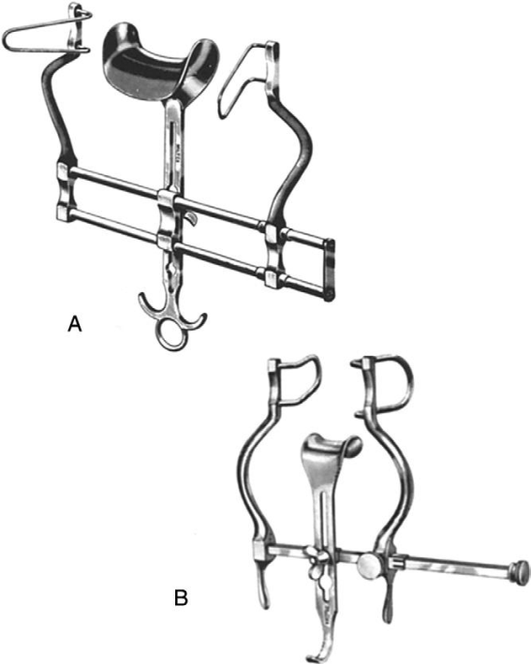
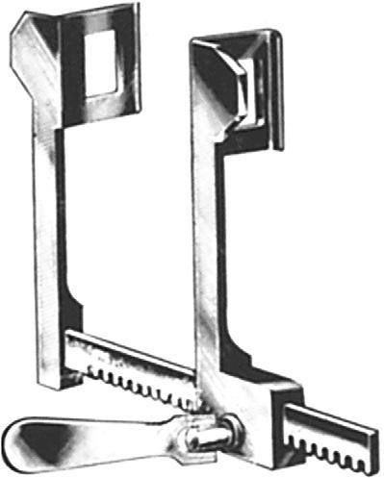
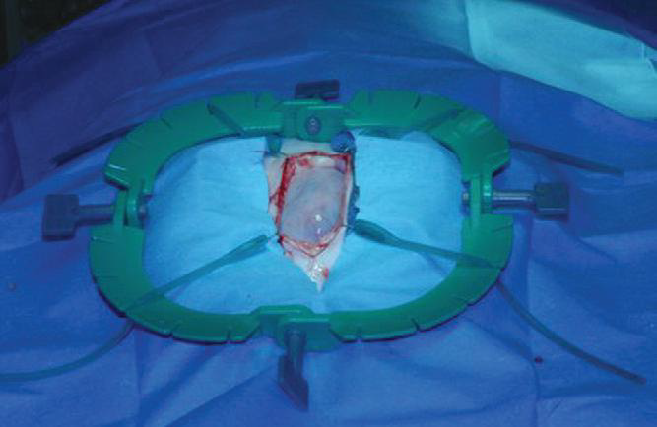
both Balfour and Finochietto retractors should be selected to match patient size.
Properly positioned ring retractors can be of great help to the solo surgeon during approach, performance, and closure of a surgical procedure
Balfour retractors with central “bladder blades.
A Finochietto rib retractor.
Ring retractors
Excessive opening of a retractor to compensate for limited exposure may lead to excessive tissue trauma (ex. fractured rib).
The more common hazard of self retaining retractors is ischemia at the pressure point.

Slide 28
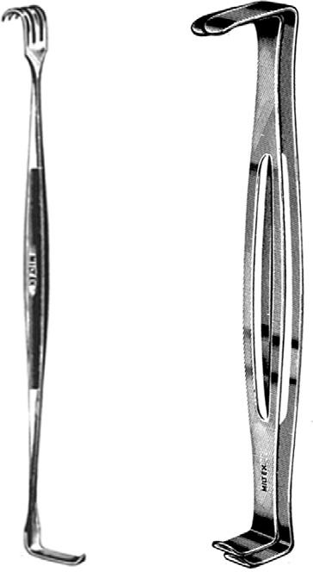
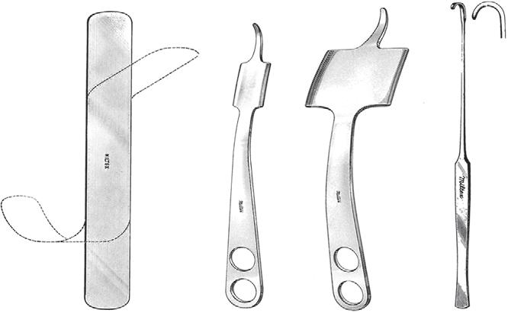
Hand-Held Retractors
Retraction using a Senn, Army-Navy, Green, or spay hook is often reserved for more superficial tissues (e.g., retracting subcutaneous tissue during abdominal wall closure)
Malleable retractors are usually intended for use on tissues in body cavities.
When the spay hook is used as a retractor, the handle or the hook may be used effectively to manipulate and protect tissues
Senn
Army-Navy.
malleable
Hohmann retractors
spay (Snook) hooks

Slide 29
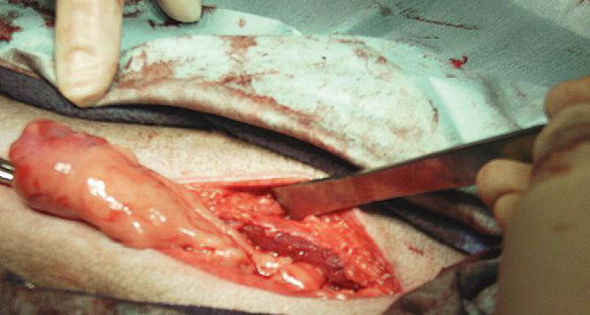
Use of a spay hook handle to retract tissue during surgery

Slide 30
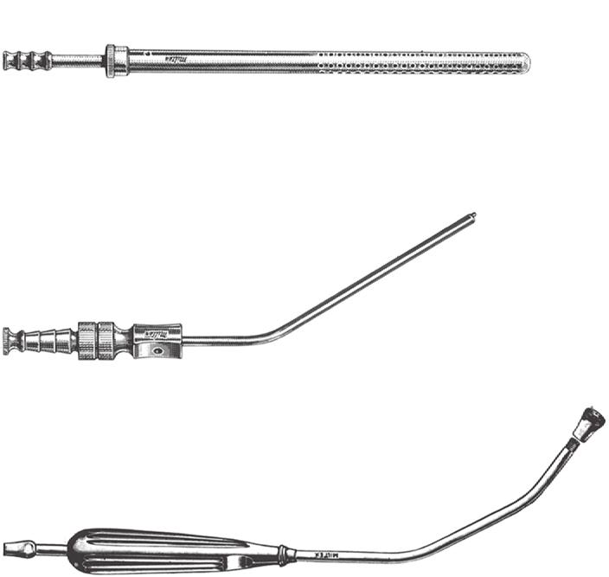
SUCTION USE
Suction is used to remove blood and fluid from the surgical site. To reveal specific bleeding points for ligation or cautery.
Poole suction tips have multiple openings and are best suited for use in body cavities.
Both diffuse and point suction can be achieved with the Poole tip by covering or exposing the single-port inner cannula.
Frazier suction tips are often used during neurosurgical and selected soft tissue procedures (e.g., bulla osteotomy).
A finger port near its end is used to vary the suction delivered at its tip.
The Yankauer suction tip may also be used
Poole suction tips
Frazier
Yankauer

